Slide 1

Advance Programming Techniques (APT)
Lecture # 5
Ehtisham Rasheed
Department of Computer Science
University of Gurjat, Gujrat

Slide 2
Object Oriented Programming
Procedural programming
Writing procedures or methods to perform specific operations on data
Object Oriented Programming
Creating objects that contain both data and methods
Advantages of OOP
Faster and easier to execute
It provides clear structure for the programs
With OOP code is easier to maintain, modify and debug
It provides code reusability and shorter development time

Slide 3
Object Oriented Programming
Class
Class is a template for objects
For Example: Fruit, Car
Object
Object is an instance of a class
Banana, Apple, Mango are instances of class Fruit
Picanto, City, Corolla are instances of class Car

Slide 4
Classes in C#
Create class and object in C#
Multiple objects
Accessing class members
Using multiple classes
Constructors
Constructor parameters

Slide 5
Access Modifiers in Classes
Public
Private
Protected
Internal

Slide 6
C# Properties and Encapsulation
Encapsulation is a technique to make sure that “sensitive” data is hidden from users. To achieve this, we must
Declare variables as private
Provide public get and set methods, through properties

Slide 7
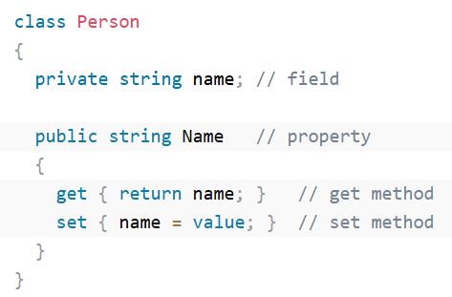
Properties

Slide 8
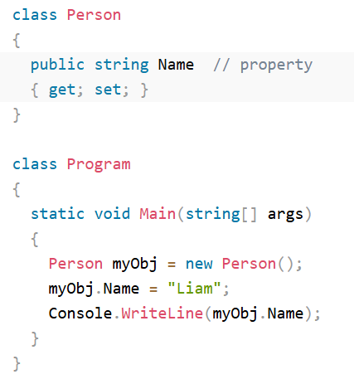
Properties (Short Hand)

